Slide 1
Perfect hash table based Telephone Directory
project Number: 04
Module Number: 04
Name: U. Mahesh
Roll Number: 49
Id Number: 170031326

Slide 2
Introduction:
This module is purely based on the Threaded Binary Tree ADT and Rewriting the insertionSort3 to illustrate how to sort the parallel arrays.
Here some of the Threaded Binary Tree ADT concepts will be used in this module.
some of the functions are:
Function: Insert
Function: Delete
Function: Search
Function: In order traversal

Slide 3
Threaded Binary Tree ADT
Threaded Binary Tree ADT or also known as Threaded Binary Tree Traversals.
Threaded Binary Tree Traversals also called as the stack/queue – less traversals.
why because, this new traversal algorithms which do not need both stacks and queues.
The binary trees which store such information in NULL pointers are called threaded binary trees.
The common convention is to put predecessor/successor information. That means, if we are dealing with preorder traversals, then for a given node, NULL left pointer will contain preorder predecessor information and NULL right pointer will contain preorder successor information. These special pointers are called threads.

Slide 4
Classifying Threaded Binary Trees
The classification is based on whether we are storing useful information in both NULL pointers or only in one of them.
• If we store predecessor information in NULL left pointers only, then we can call such binary trees left threaded binary trees.
• If we store successor information in NULL right pointers only, then we can call such binary trees right threaded binary trees.
• If we store predecessor information in NULL left pointers and successor information in NULL right pointers, then we can call such binary trees fully threaded binary trees or simply threaded binary trees.

Slide 5
Types of Threaded Binary Trees
Based on above discussion we get three representations for threaded binary trees.
• Preorder Threaded Binary Trees: NULL left pointer will contain PreOrder predecessor information and NULL right pointer will contain PreOrder successor information.
• Inorder Threaded Binary Trees: NULL left pointer will contain InOrder predecessor information and NULL right pointer will contain InOrder successor information.
• Postorder Threaded Binary Trees: NULL left pointer will contain PostOrder predecessor information and NULL right pointer will contain PostOrder successor information.

Slide 6
Threaded Binary Tree structure
Any program examining the tree must be able to differentiate between a regular left/right pointer and a thread. To do this, we use two additional fields in each node, giving us, for threaded trees, nodes of the following form:
Struct node{
Struct node *LEFT;
Int LTAG;
Int DATA;
Int RTAG;
Struct node *RIGHT;
};
LEFT | LTAG | DATA | RTAG | RIGHT

Slide 7
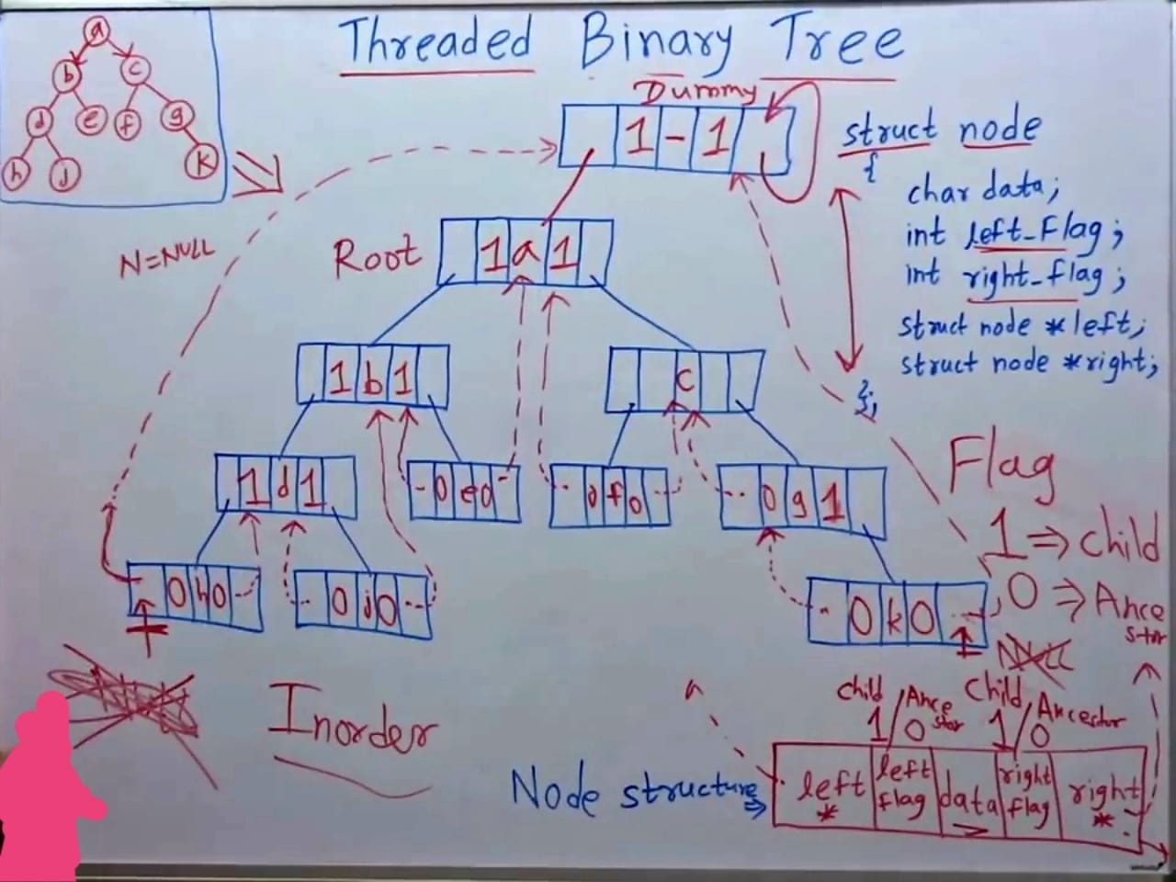
Example image

Slide 8
Finding Inorder Successor in Inorder Threaded Binary Tree
Strategy: If P has a no right subtree, then return the right child of P. If P has right subtree, then return the left of the nearest node whose left subtree contains P.
Struct node *InorderSuccessor(Struct node *p){
Struct node *position;
If(p->RTAG==0)
return p->RIGHT;
else{
position=p->RIGHT;
while(position->LTAG==1)
position=position->LEFT;
return position;}
}

Slide 9
Inorder Traversal in Inorder Threaded Binary Tree
We can start with dummy node and call Inordersuccessor() to visit each node until we reach dummy node.
void inordertraversal(Struct node *root){
Struct node *p= InorderSuccessor(root);
while(p!=root){
p= InorderSuccessor(p);
printf(“%d”,p->DATA);
}
}

Slide 10
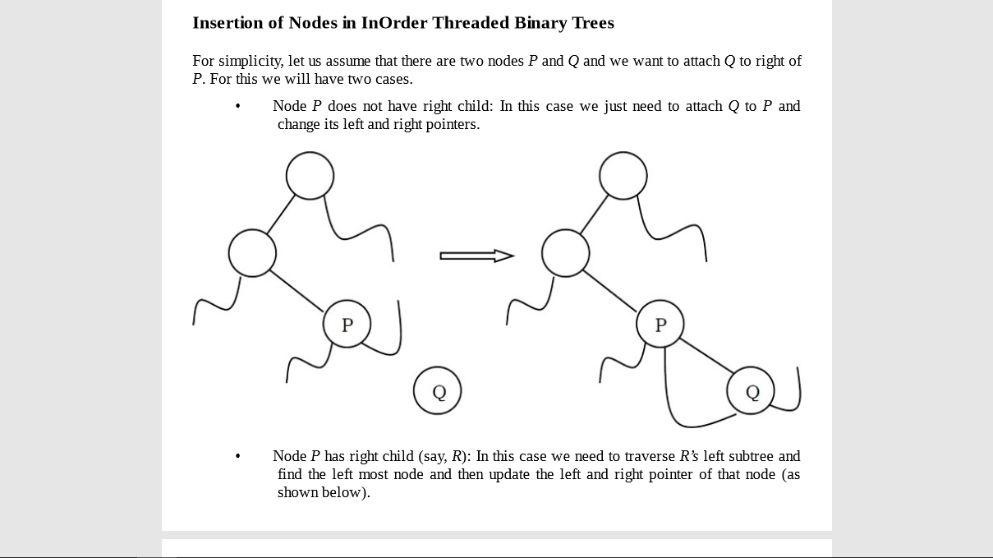

Slide 11
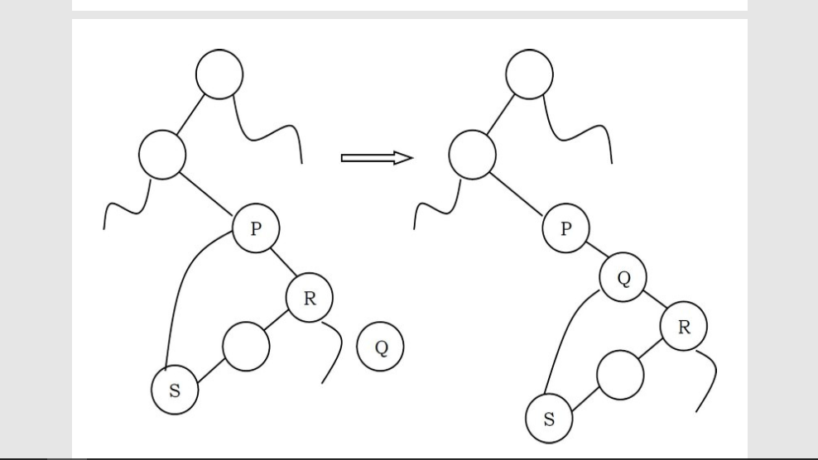

Slide 12
Inserting element into a TBT
Void InserRightInorderTBT(struct ThreadedBinaryTreeNode *p, struct ThreadedBinaryTreeNode *Q){
struct ThreadedBinaryTreeNode *Temp;
Q->RIGHT=P->RIGHT;
Q->RTAG=P->RTAG;
Q->LEFT=P;
Q->LTAG=0;
P->RIGHT=Q;
P->RTAG=1;
If(Q->RTAG==1)
Temp=Q->RIGHT;
While(Temp->LTAG)
Temp=Temp->LEFT;
Temp->LEFT=Q;
}
}

Slide 13
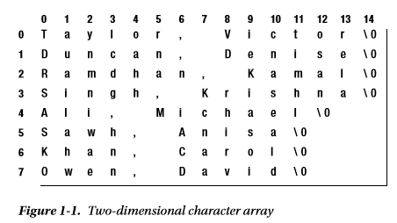
InsertionSort3 to sort parallel arrays (Sorting An Array Of Strings)

Slide 14
To cater for longer names, we can increase 15, and to cater for more names, we can increase 8. The process of sorting list is essentially the same as sorting an array of integers. The major difference is that whereas we use < to compare two numbers, we must use strcmp to compare two names. In the function insertionSort shown at the end of Section 1.3, the while condition changes from this:
while (k >= lo && key < list[k])
to the following, where key is now declared as char key[15]:
while (k >= lo && strcmp(key, list[k]) < 0)
Also, we must now use strcpy (since we can’t use = for strings) to assign a name to another location. Here is the complete function:

Slide 15
insertionSort3 code
void insertionSort3(int lo, int hi, int max, char list[][max]) {
//Sort the strings in list[lo] to list[hi] in alphabetical order.
//The maximum string size is max - 1 (one char taken up by \0
char key[max];
for (int h = lo + 1; h <= hi; h++) {
strcpy(key, list[h]);
int k = h - 1; //start comparing with previous item
while (k >= lo && strcmp(key, list[k]) < 0) {
strcpy(list[k + 1], list[k]);
--k;
}
strcpy(list[k + 1], key);
} //end for
} //end insertionSort3

Slide 16
#include <stdio.h>
#include <string.h>
#define MaxNameSize 14
#define MaxNameBuffer MaxNameSize+1
#define MaxNames 8
int main() {
void insertionSort3(int, int, int max, char [][max]);
char name[MaxNames][MaxNameBuffer] = {"Taylor, Victor", "Duncan, Denise", "Ramdhan, Kamal", "Singh, Krishna", "Ali, Michael", "Sawh, Anisa", "Khan, Carol", "Owen, David" };
insertionSort3(0, MaxNames-1, MaxNameBuffer, name);
printf("\nThe sorted names are\n\n");
for (int h = 0; h < MaxNames; h++)
printf("%s\n", name[h]);
} //end

Slide 17
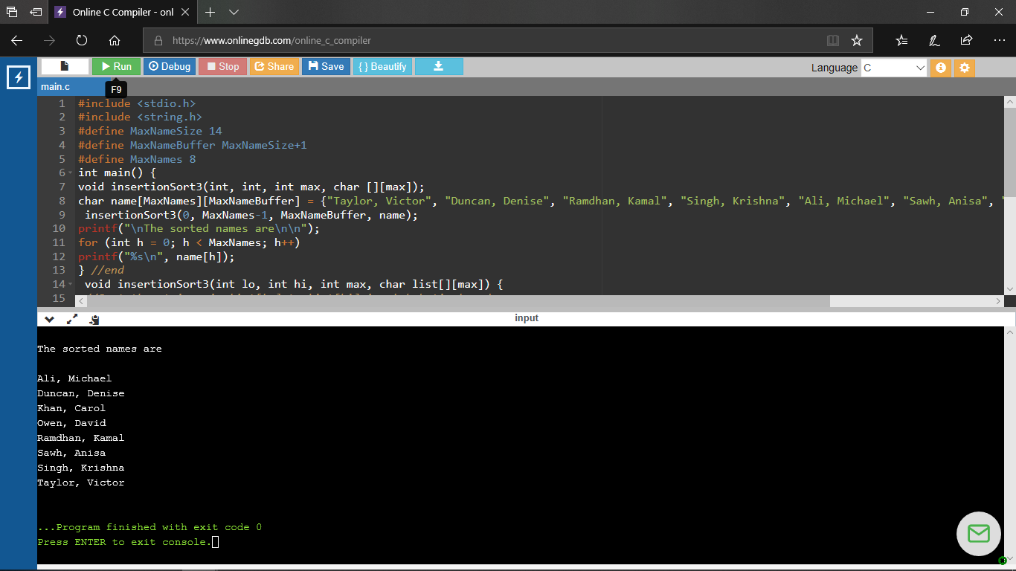
Output:

Slide 18
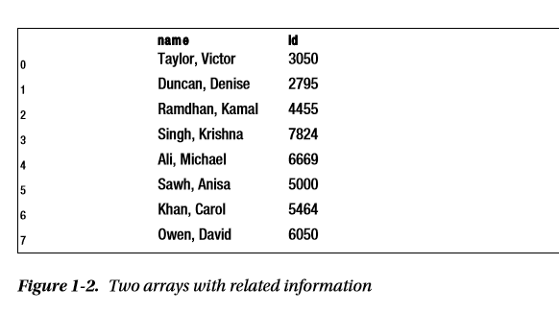
Sorting Parallel Arrays
It is quite common to have related information in different arrays. For example, suppose, in addition to name, we have an integer array id such that id[h] is an identification number associated with name[h], as shown in Figure 1-2.

Slide 19
Consider the problem of sorting the names in alphabetical order. At the end, we would want each name to have its correct ID number. So, for example, after the sorting is done, name[0] should contain “Ali, Michael” and id[0] should contain 6669.
To achieve this, each time a name is moved during the sorting process, the corresponding ID number must also be moved. Since the name and ID number must be moved “in parallel,” we say we are doing a parallel sort or we are sorting parallel arrays.
We rewrite insertionSort3 to illustrate how to sort parallel arrays. We simply add the code to move an ID whenever a name is moved. We call it parallelSort

Slide 20
Parallel Sort
void parallelSort(int lo, int hi, int max, char list[][max], int id[]) {
//Sort the names in list[lo] to list[hi] in alphabetical order, ensuring that //each name remains with its original id number.
//The maximum string size is max - 1 (one char taken up by \0).
char key[max];
for (int h = lo + 1; h <= hi; h++) {
strcpy(key, list[h]);
int m = id[h]; // extract the id number
int k = h - 1; //start comparing with previous item
while (k >= lo && strcmp(key, list[k]) < 0) {
strcpy(list[k + 1], list[k]);
id[k + 1] = id[k]; // move up id number when we move a name
--k;
}
strcpy(list[k + 1], key);
id[k + 1] = m; // store the id number in the same position as the name
} //end for
} //end

Slide 21
#include <stdio.h>
#include <string.h>
#define MaxNameSize 14
#define MaxNameBuffer MaxNameSize+1
#define MaxNames 8
int main() {
void parallelSort(int, int, int max, char [][max], int[]);
char name[MaxNames][MaxNameBuffer] = {"Taylor, Victor", "Duncan, Denise", "Ramdhan, Kamal", "Singh, Krishna", "Ali, Michael", "Sawh, Anisa", "Khan, Carol", "Owen, David" };
int id[MaxNames] = {3050,2795,4455,7824,6669,5000,5464,6050};
parallelSort(0, MaxNames-1, MaxNameBuffer, name, id);
printf("\nThe sorted names and IDs are\n\n");
for (int h = 0; h < MaxNames; h++)
printf("%-18s %d\n", name[h], id[h]);
} //end main

Slide 22
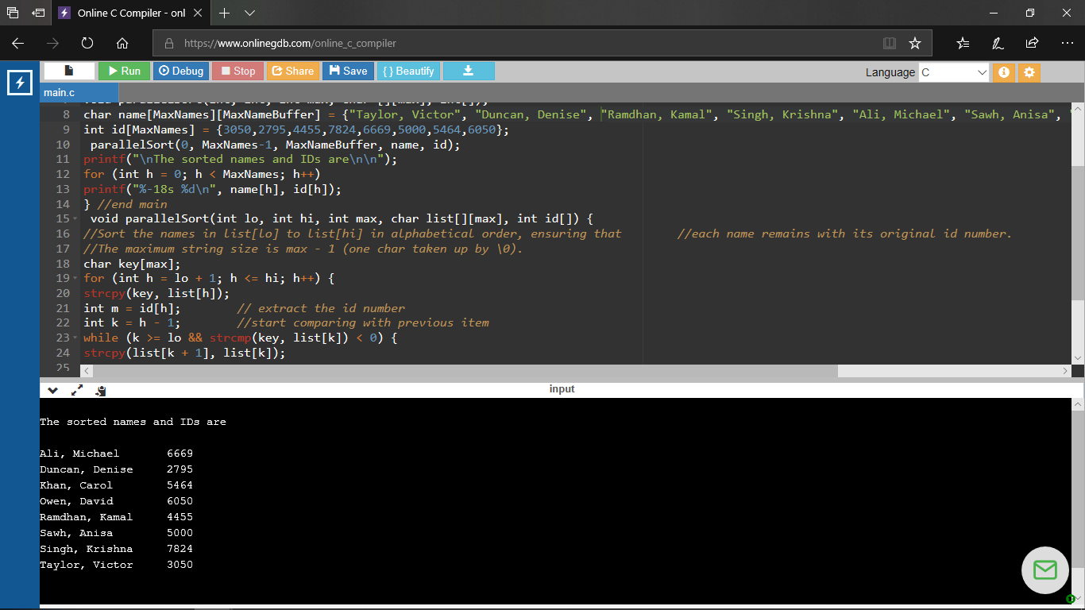
Output:

Slide 23
Merging ordered lists code
#include<bits/stdc++.h>
using namespace std;
struct Node
{
int data;
struct Node *next;
};
Node *newNode(int key)
{
struct Node *temp = new Node;
temp->data = key;
temp->next = NULL;
return temp;
}

Slide 24
void printList(Node *node)
{ while (node != NULL) {
printf("->%d", node->data);
node = node->next;
} }
Node *merge(Node *h1, Node *h2)
{ if (!h1)
return h2;
if (!h2)
return h1;
if (h1->data < h2->data) {
h1->next = merge(h1->next, h2);
return h1;
}
else {
h2->next = merge(h1, h2->next);
return h2;
} }

Slide 25
int main()
{
Node *head1 = newNode(1);
head1->next = newNode(3);
head1->next->next = newNode(5);
Node *head2 = newNode(0);
head2->next = newNode(2);
head2->next->next = newNode(4);
Node *mergedhead = merge(head1, head2);
printList(mergedhead);
return 0;
}

Slide 26
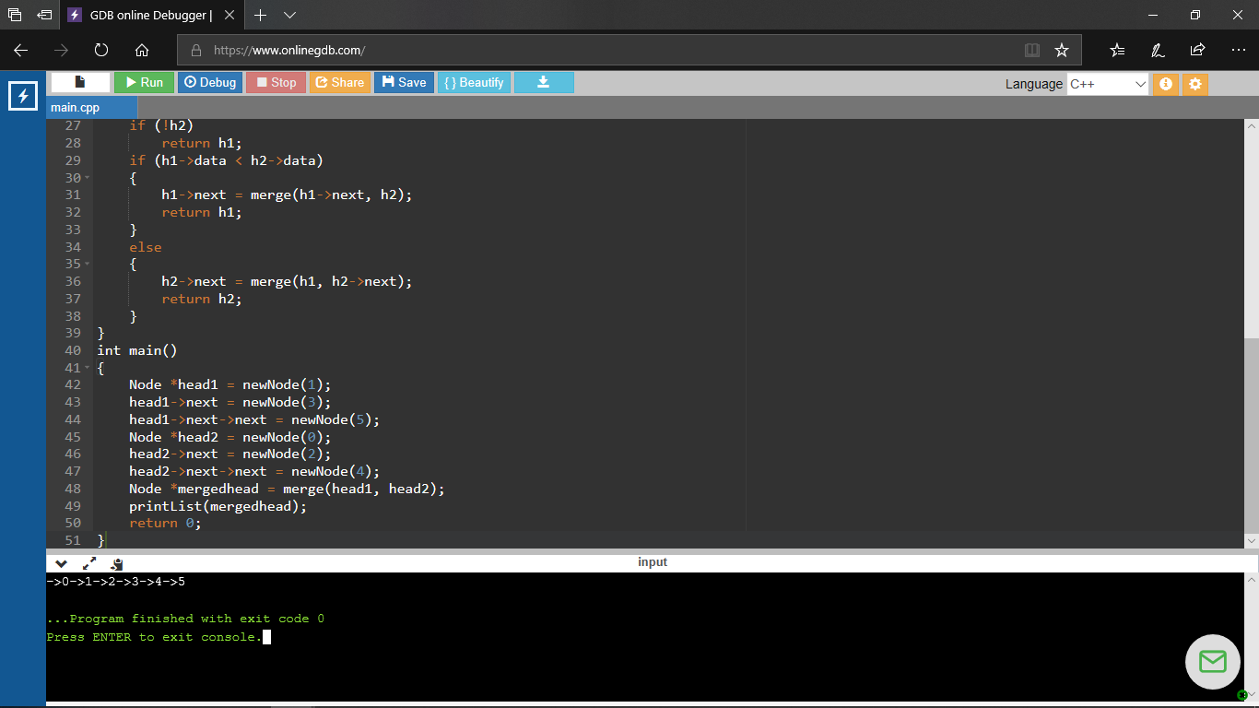
output

